Slide 1
Ethics in UX Research

Slide 2

Why Ethics Matter in UX Research
UX research increasingly influences product design and user interactions
Potential impact of unethical practices on users and businesses
Notes:
Explain that as UX research increasingly influences product design and user interactions, ethical considerations are critical to ensure trust and integrity.
Discuss that unethical practices can lead to privacy violations, data misuse, and participant harm, which can result in user distrust and legal consequences.

Slide 3

Core Ethical Principles
Informed Consent
Privacy and Confidentiality
Non-Maleficence (don’t do bad stuff)
Beneficence (try to do good stuff)
Justice
Notes:
Informed Consent: Participants need to know what the research involves and how their data will be used to make an informed decision to participate.
Privacy and Confidentiality: Respecting participant data by anonymizing it and securing storage to protect against breaches.
Non-Maleficence: Design studies to minimize risks and prevent harm, such as psychological distress or misuse of personal data.
Beneficence: Research should aim to contribute positively, providing benefits like improved user experiences or societal advancements.
Justice: Ensure research inclusivity, representing diverse demographics fairly and avoiding exploitation or discrimination.

Slide 4

Obtaining Informed Consent
Clear explanation of the research purpose
Only deceive if there’s no other alternative
Use an IRB
Details on what participation involves
Rights of the participants (e.g., to withdraw at any time)
Notes:
Define informed consent as the process of providing participants with all necessary information to make a voluntary decision about their involvement.
Explain the steps:
- Purpose: Clearly state why the research is being conducted.
- Process: Outline what participants will do and what data will be collected.
- Rights: Inform participants they can withdraw at any time without penalty.

Slide 5
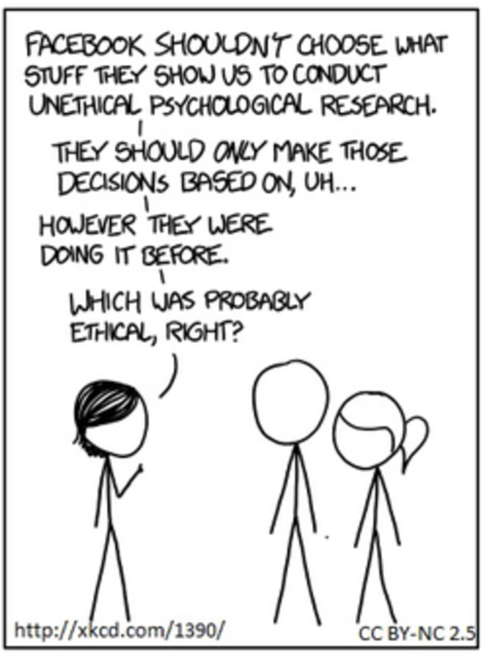
Facebook Emotional Contagion Study (2014)
Facebook manipulated the news feeds of nearly 700,000 users to study emotional contagion without their consent.
Loss of trust in the company.
Backlash from users because of emotional manipulation and lack of ethical standards
Notes:
Explain that as UX research increasingly influences product design and user interactions, ethical considerations are critical to ensure trust and integrity.
Discuss that unethical practices can lead to privacy violations, data misuse, and participant harm, which can result in user distrust and legal consequences.
Highlight the Facebook emotional contagion study: In 2014, Facebook manipulated the news feeds of nearly 700,000 users to study emotional contagion without their consent. The study faced significant backlash because users were unaware of their participation and potential emotional manipulation, leading to trust issues and questions about Facebook's ethical standards.

Slide 6

Protecting Participant Privacy
Importance of privacy in UX research
Techniques for ensuring confidentiality:
Anonymizing data
Secure data storage
Limiting data access
Legal considerations (e.g., GDPR, CCPA, HIPPA)
Notes:
Emphasize the importance of privacy, noting that breaches can lead to personal harm and legal issues.
Techniques for confidentiality:
- Anonymizing data by removing identifying information to protect participant identities.
- Secure data storage using encryption and secure servers.
- Limiting access to data to only essential team members.
Discuss legal frameworks:
- GDPR: General Data Protection Regulation, a regulation in EU law on data protection and privacy.
- CCPA: California Consumer Privacy Act, a state statute intended to enhance privacy rights and consumer protection for residents of California.
Highlight the need for robust privacy practices to comply with these regulations and protect participants.

Slide 7

Facebook and Cambridge Analytica (2018)
This is Your Digital Life App
270,000 direct users, ultimately collected data from 87 million users
Sold to Cambridge Analytica
Used to build psychological profiles of users allegedly used to influence voter behavior in 2016 election through targeted political advertising
Notes:
Developed by Aleksandr Kogan, a psychology professor at Cambridge University. The app was a personality quiz that collected data from users and also accessed the data of the users' Facebook friends. This method exploited Facebook's API, which at the time allowed apps to collect extensive data not only from users who installed the app but also from their friends..
which used it to build detailed psychological profiles of users. These profiles were then allegedly used to influence voter behavior through targeted political advertising during the 2016 U.S. presidential election and the Brexit referendum. The data allowed Cambridge Analytica to deliver highly personalized political ads to sway public opinion.
Following the scandal, Facebook faced multiple investigations and lawsuits. The U.S. Federal Trade Commission (FTC) fined Facebook $5 billion, the largest fine ever imposed for violating consumer privacy. Additionally, new regulations, such as the General Data Protection Regulation (GDPR) in the European Union, were reinforced to better protect user data.
In response to the scandal, Facebook made several changes to its platform and data policies. It restricted the amount of data that third-party apps could access and increased transparency regarding data collection and use. Additionally, Cambridge Analytica ceased operations in 2018 amid growing scrutiny and legal challenges.

Slide 8

Non-Maleficence (Don’t do bad stuff!)
Identifying potential risks to participants
Mitigating risks through careful study design
Monitoring for and addressing adverse effects during research
Notes:
Identify potential risks such as emotional distress, privacy breaches, and physical discomfort.
Mitigate risks by:
- Designing studies to minimize invasiveness and ensuring they are ethically reviewed.
- Pilot testing to identify unforeseen issues.
- Including debriefing sessions to address any discomfort participants might experience.

Slide 9

Dark Patterns Disguised as Research
Manipulative UI/UX to coerce user actions
Examples: pre-checked add-ons, hidden fees, difficult opt-outs
Airlines: default travel insurance, hidden baggage fees
E-Commerce: urgency timers, confusing cancellation flows

Slide 10
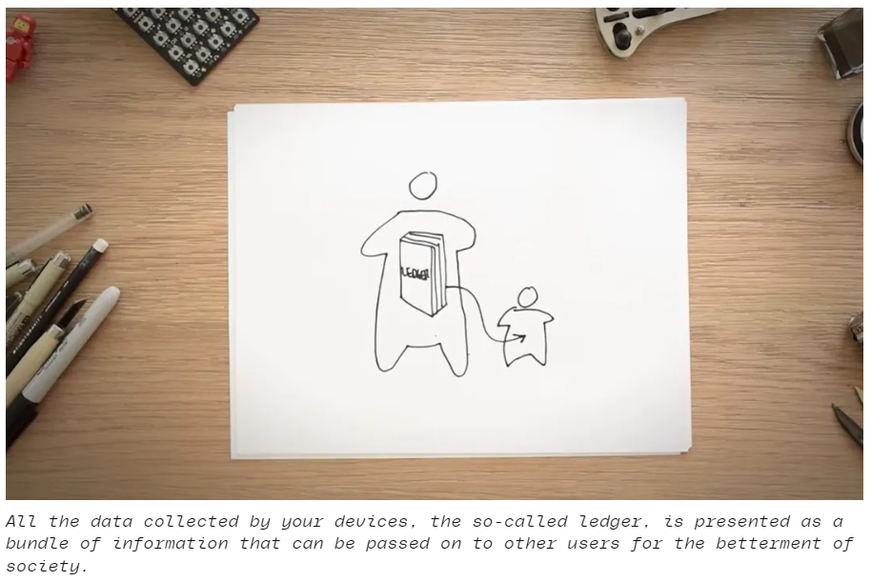

Google’s Selfish Ledger (2018)
Leaked “concept” video showing how user data could be used to modify behavior for “societal good”.
Images from The Verge
Notes:
Example: Google's 2018 "Selfish Ledger" Concept Video
Overview: In 2018, a leaked internal video from Google titled "The Selfish Ledger" presented a dystopian vision of how user data could be used for behavior modification. The video was intended as a thought experiment for internal use but raised significant ethical concerns.
Deception: The video depicted a scenario where Google could use its vast amounts of user data to influence and guide user behavior towards specific outcomes, effectively altering user behavior for perceived societal good. Although this was a conceptual and speculative project, it was presented in a way that suggested the possibility of real-world application.
Ethical Issues:
Manipulation: The concept suggested manipulating user behavior without their explicit consent.
Privacy Concerns: It highlighted the potential for invasive data collection and use.
Lack of Transparency: Users were not made aware of the potential for such extensive use of their data.

Slide 11

Beneficence in UX Research (Try to do good stuff!)
Designing research that provides value to participants and society
Balancing research goals with participant well-being
Notes:
Explain beneficence as the principle of maximizing positive outcomes from research.
Design studies to not only avoid harm but to provide value, such as improving product usability or contributing to social good.
Share examples where UX research led to significant improvements, such as accessible design for disabled users.
Emphasize the balance between research goals and participant well-being, ensuring participants also benefit from the research through compensation, feedback, or enhanced experiences.

Slide 12

Crash-Test Dummies
Early crash test dummies were modeled on the 50th-percentile male body.
5’9” and 170lbs
Dummies that were supposed to represent the size and shape of children and women were not included until the 1980s.
The first female 50th percentile dummy was not tested until 2023!
Sierra Sam (1949) originally developed for testing airplane ejection seats
Notes:
Modern crash test dummies are now representative of more groups including the elderly and obese.

Slide 13

Mozilla’s Heartbeat User Feedback System
Gather real-time user feedback about browsing experience
Informed consent
Anonymized feedback and secure data storage
Transparency about project
User-centered design and continuous improvement
Notes:
Explain beneficence as the principle of maximizing positive outcomes from research.
Design studies to not only avoid harm but to provide value, such as improving product usability or contributing to social good.
Share examples where UX research led to significant improvements, such as accessible design for disabled users.
Emphasize the balance between research goals and participant well-being, ensuring participants also benefit from the research through compensation, feedback, or enhanced experiences.
Overview: Mozilla, the organization behind the Firefox web browser, implemented a system called "Heartbeat" to gather real-time user feedback about their browsing experience. The feedback system aimed to understand user satisfaction and identify areas for improvement in the browser.
Beneficial Aspects:
User-Centered Design: Heartbeat actively involved users in the design process by collecting their opinions and experiences directly.
Real-Time Feedback: Users could provide feedback on specific features or changes in the browser, allowing Mozilla to make timely and relevant updates.
Transparency: Mozilla was transparent about the purpose of the feedback system and how the data would be used to improve the product.
Ethical Practices:
Informed Consent: Users were informed about the feedback system and had the option to participate or not, ensuring voluntary participation.
Privacy and Confidentiality: Mozilla maintained user privacy by anonymizing feedback and securely storing data.
Beneficence: The feedback system aimed to improve the browser experience, directly benefiting users by addressing their needs and preferences.
Positive Outcomes:
Improved User Experience: The continuous feedback loop helped Mozilla identify and fix issues quickly, leading to a better overall user experience.
Community Engagement: Users felt more connected to the product and its development, fostering a sense of community and collaboration.
Product Development: The insights gathered from the feedback system informed product development decisions, ensuring that changes aligned with user needs and preferences.

Slide 14

Justice in UX Research
Ensuring diverse and representative participant samples
Study materials in large print and other languages
Including seniors and others who aren’t tech-savvy
Transparency in study reporting and conflicts of interest
Notes:
Justice involves ensuring fair treatment and equitable distribution of research benefits and burdens.
Recruit diverse participant samples to avoid skewed data that can result from homogeneous groups.
Avoid bias in research design, data interpretation, and reporting by using inclusive language and practices.
Provide equal opportunities for all potential participants, ensuring accessibility for underrepresented groups.

Slide 15

Xbox Adaptive Controller
Designed with extensive input from gamers with disabilities
Promoting inclusivity in the gaming community
Highly customizable to accommodate various physical needs
Notes:
Xbox Adaptive Controller:
Developed with extensive input from gamers with disabilities.
Features a highly customizable design to accommodate various physical needs.
Ensures that gaming is accessible to a wider audience, promoting inclusivity in the gaming community.
Seeing AI App:
A mobile app designed for visually impaired users.
Uses AI to describe people, text, and objects to help visually impaired users navigate their environment.
Developed through direct feedback from visually impaired users to ensure it meets their needs.
Lessons Learned:
Inclusion Leads to Innovation: By designing for users with disabilities, Microsoft often discovers innovative solutions that improve the user experience for all.
Importance of Representation: Ensuring that diverse user groups are represented in research leads to more equitable and effective products.
Ongoing Commitment: Inclusive design is an ongoing process that requires continual engagement with diverse user groups to ensure that products remain accessible and fair.

Slide 16

The World’s First Bionic Drummer

Slide 17
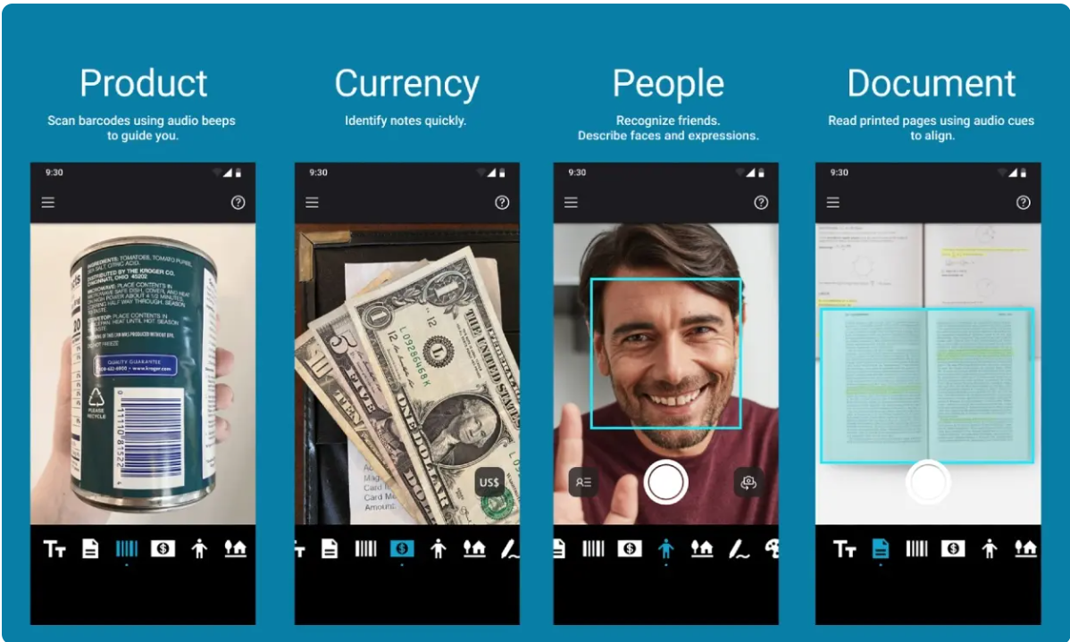
Seeing AI App
Mobile app developed through direct feedback from visually impaired users
Uses AI to describe people, text and objects to help visually impaired users navigate their environment
Notes:
Seeing AI App:
A mobile app designed for visually impaired users.
Uses AI to describe people, text, and objects to help visually impaired users navigate their environment.
Developed through direct feedback from visually impaired users to ensure it meets their needs.

Slide 18

Key Takeaways
Adhere to core ethical principles
Maintain transparency and trust
Promote inclusivity and justice
Notes:
Adhere to Core Ethical Principles:
Ensure informed consent, protect privacy, avoid harm, provide benefits, and ensure fairness in all UX research practices.
Maintain Transparency and Trust:
Be transparent with participants about research goals and methods, and build trust by safeguarding their data and rights.
Promote Inclusivity and Justice:
Strive for inclusive research that represents diverse user groups and ensures equitable treatment, leading to more innovative and effective designs.

